Slide 1
Imagine Cup Junior
Lesson Two - What is AI?
Notes:
This is a title slide that you can have up at the beginning of Lesson 2 of the Imagine Cup Junior for Beginners.

Slide 2

Challenge Check-in
What have you done so far?
In Lesson One you have learned what Imagine Cup Junior is.
You formed a team and identified a specific problem from one of the AI for Good categories. You have formed a team, selected a problem and learned more about it.
Before this Lesson you may have filled out Slide 2 on your PowerPoint Submission Template.
What is next?​
​
In this lesson you are going to learn about the basics of AI and how to build with APIs.
Notes:
Challenge Check-in. This slide is a check-in to recap what the students have learned so far and what is coming next!

Slide 3






What we will be doing across the six Imagine Cup Junior lessons.
Lesson 1
Lesson 2
Lesson 3
Forming your team and choosing your problem.
Learning about how AI works.
Learning about generative AI.
Lesson 4
Lesson 5
Lesson 6
Becoming a team of AI inventors.
Making sure your AI is good and cyber secure.
Entering a great submission to Imagine Cup Junior.
Notes:
This slide provides a short overview of the six lessons your class will take part in.

Slide 4
Submission Tips
Your team will be learning about AI in this lesson. To score well in Imagine Cup Junior keep in mind that you need to:
Ensure your team’s concept is AI, and that you have used the APIs.
Try to think of ways that it can truly solve your identified problem in a really powerful way using AI.
Notes:
These Submission Tips are designed to help you students to stay focused in this lesson, and ensure they are building their AI with the above points in mind.

Slide 5

In what ways have you used AI today?
Class Reflection
Notes:
Rapid Reflection – To engage your students with this lesson, ask them to work in their teams (or as a whole class) to brainstorm the ways that they think they have used artificial intelligence today.
lesson.

Slide 6
What is human intelligence?
Notes:
We are now going to step through a basic introduction to artificial intelligence, starting with a discussion of human intelligence.

Slide 7





Human Intelligence is made up of:
Reasoning
Humans thinking about things.
Learning
Humans learning new things.
Problem Solving
Humans coming
up with solutions
to problems.
Perception
Humans being able to see, or hear, or touch, or feel etc.
Linguistic Intelligence
Humans being able
to speak languages.
Notes:
Artificial Intelligence can be a very complex concept, so in the coming slides we step through in a very simple way. The goal by the end of this is that your students know how to build AI concepts, drawing on tools that are known as APIs. We start this learning process by engaging with the concept of human intelligence. On Slide 7 we break down five different ways that humans demonstrate their intelligence. We would encourage you to connect these specifically to the experiences of the students in your class. For example, you could ask them how many languages they speak themselves, or what problems they have had to solve today.

Slide 8
What is artificial intelligence?
Notes:
Now we are interested in how many of these elements of human intelligence can also be achieved artificially. In the next slide we give your students time to discuss this.

Slide 9
Rapid Reflection
So could a machine, robot or computer program do these things?
Reasoning
Could they think
about things?
Learning
Could they learn new things?
Problem Solving
Could they come up with solutions to problems?
Perception
Could they see, or hear, or touch, or feel?
Linguistic Intelligence
Could they speak a language?
Notes:
Rapid Reflection – Where Slide 7 described elements of human intelligence, now have your students explore whether a machine, robot or computer program could also do these things. What we are moving to here is the definition of AI, which is the idea that a machine, robot or computer program could think or do things in a similar way that we do as humans. If you have time you may want to bring this discussion from the teams back to a whole class discussion at the completion of the two minutes.

Slide 10

AI is quite simply…
an attempt to make a computer, a robot, or other piece of technology ‘think’ and do some things like humans.
Notes:
Here we define what artificial intelligence is. There are plenty of definitions out there, but in Imagine Cup Junior for Beginners we use this simple overview. ‘Artificial Intelligence is an attempt to make a computer, a robot, or other piece of technology ‘think’ and process data in the same way as we humans do.’

Slide 11
A Brief History of AI
1997: IBM’s Deep Blue beats a chess champion
1960s: Early AI programs developed
2010s: Rise of Neural Networks
1950s: Birth of AI
1956: The term “Artificial Intelligence” coined
1980s: Expert systems and rule-based AI
2000s: Machine Learning gains popularity
2020s: Large Language Models and Generative AI
Notes:
A brief history of AI: Highlight key moments of technology evolution that brought us to the current state of AI today. The emphasis here is to tell the story of how AI came to be and to introduce some other terms related to AI. Tell students that they will learn more about generative AI in the next lesson.

Slide 12
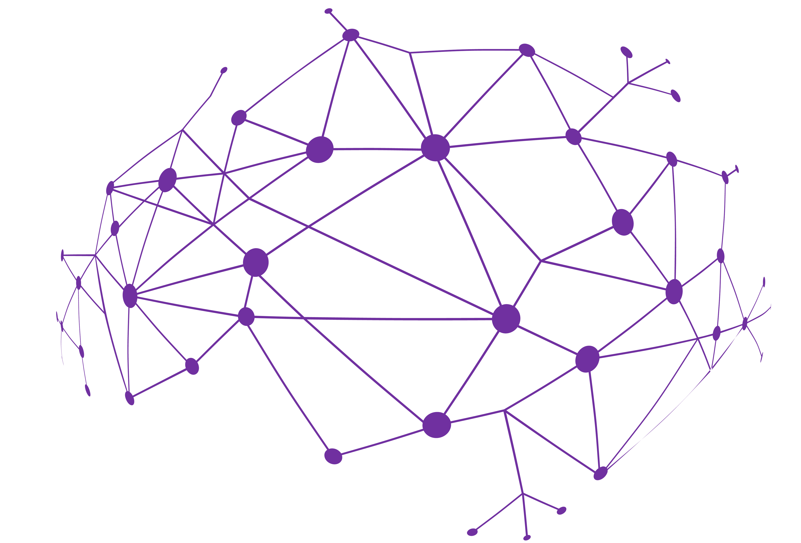
Recap of Key Terms
Machine Learning: Computers learning from data to make decisions or predictions.
Neural Network: A computer system inspired by the human brain, used in deep learning.
Large Language Models: Advanced AI models understanding and generating human-like text.
Chatbots: AI programs that chat with people, like virtual assistants.
Generative AI: AI that creates new content, like art or text, on its own.
Notes:
Recap of key terms: The timeline introduced a few key terms that support students in furthering their understanding of AI. These terms are: Machine Learning, Neural Network, Large Language Models, Chatbots, and Generative AI.

Slide 13

Sprint 1
Investigating AI
Sprint 2
Choosing a Problem
Sprint One – Investigating AI
Goals:
As a team, go online to research how people have already used AI to try to solve the problem that you have decided to work on as a team.
Hints:
As you research AI solutions that already exist, keep a record of them, because when you start innovating you will want to make sure your idea is different!
Notes:
Sprint #1 – In the first ten-minute sprint of Lesson 2 your students can work in their teams to go online to research how people have already used AI to try to solve the problem that they have decided to work on as a team. This is a useful use of their time, as one of the ways that their submissions are judged is on how innovative they are. This early research allows them to keep a record of what people have already invented on that problem and helps them to ensure that the idea they end up submitting is different.

Slide 14
Class Reflection
What did you find in your research sprint?
Did you find any interesting AI solutions to the specific problem your team wants to solve?
Notes:
Rapid Reflection – As a way of bringing your students back from their sprint, this is a chance to reflect as a class, and again for you as their teacher to emphasize that when they do begin to innovate their ideas that they are creating something unique and new!

Slide 15
So how does AI work?
The 1,2,3 Step Process
Step 1
Data is collected.
Step 1
Data is collected.
Step 2
This data goes into the AI.
Step 2
This data goes into the AI.
Step 2
This data goes into the AI.
Step 3
A decision or outcome is created by the AI.
Notes:
In our training of students around the world in AI, we have found the simple process that we step through in the next slides very easy for them to understand. Essentially AI can be though of as:
Step 1: Data is collected.
Step 2: This is received by the AI.
Step 3: A decision or outcome is created.
We will use this approach in the coming lessons to help your students create their AI concepts, so this is an important process to help them understand. At Step 1, we can therefore ask the question of what data is collected, and also how it is collected. This is a good setup for the next video, which explains the Microsoft Cognitive Services and the very important tool called APIs.

Slide 16
Let’s break this down step by step…
Step 1
Data is collected.
How can data be collected by a machine, robot or piece of technology?
Notes:
In our training of students around the world in AI, we have found the simple process that we step through in the next slides very easy for them to understand. Essentially AI can be though of as:
Step 1: Data is collected.
Step 2: This is received by the AI.
Step 3: A decision or outcome is created.
We will use this approach in the coming lessons to help your students create their AI concepts, so this is an important process to help them understand. At Step 1, we can therefore ask the question of what data is collected, and also how it is collected. This is a good setup for the next video, which explains the Microsoft Cognitive Services and the very important tool called APIs.

Slide 17
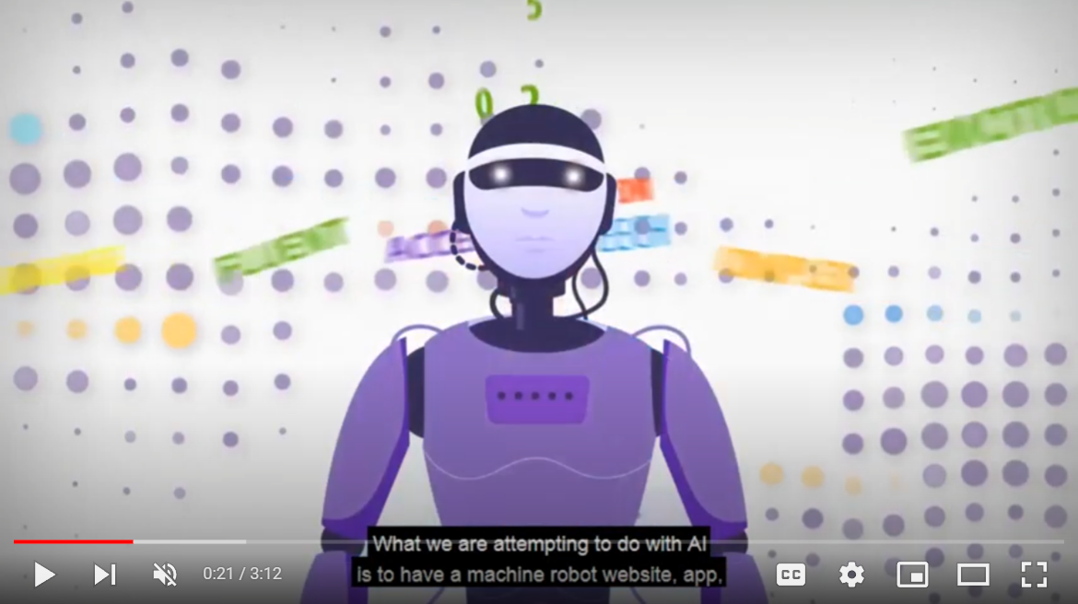

Introduction to Cognitive Services
Introduction to Cognitive Services | https://youtu.be/3tkwaxpoAUA
Notes:
This video explains the five Microsoft Cognitive Services which are the key areas that Microsoft is supporting the development of AI around the world. Within each of these five services are the various APIs that are currently available (and this list is continually growing). If your students can build out their AI concepts using the APIs, they will score well in the AI section of the judging rubric (this rubric is included at the end of this slide deck).

Slide 18
Microsoft's Cognitive Services
Microsoft has developed many AI tools that AI inventors and developers can use. These are known as the cognitive services, and there are five of them. Within each of them are tools called APIs.
Vision
AI that identifies and analyses content within images, videos, and digital ink.
Speech
AI that integrates
speech processing into apps and services.
Language
AI that helps to extract meaning from words and sentences.
Search
AI to help you find what you’re looking for from the internet.
Decision AI to help make smarter decisions faster.
Notes:
Slide 18 shows the five Microsoft Cognitive Services and Slide 19 shows the currently available APIs, which were discussed in the video at Slide 17. If your students would like to explore the difference cognitive services they can find more information at this page: Cognitive Services – APIs for AI Developers | Microsoft Azure

Slide 19
APIs that sit under each of the cognitive services
There are many APIs that sit under each of the cognitive services. APIs are essentially software tools that AI developers can use to quickly and simply build out their AI ideas. Here is an overview of them, and you will explore them yourselves shortly.
Vision Computer Vision
Analyze content in images and video.
Custom Vision
Customize image recognition to fit your business needs.
Face
Detect and identify people and emotions in images.
Form Recognizer
Extract text, key-value pairs, and tables from documents.
Ink Recognizer Recognize digital ink and handwriting, and pinpoint common shapes.
Video Indexer
Analyze the visual and audio channels of a video, and index its content.
Speech
Speech to Text
Transcribe audible speech into readable, searchable text.
Text to Speech
Convert text to lifelike speech for more natural interfaces.
Speech Translation
Integrate real-time speech translation into your apps.
Speaker Recognition
Identify and verify the people speaking based on audio.
Language
Immersive Reader
Help readers of all abilities comprehend text using audio and visual cues.
Language Understanding
Build natural language understanding into apps, bots, and IoT devices.
QnA Maker
Create a conversational question and answer layer over your data.
Text Analytics
Detect sentiment, key phrases, and named entities.
Translator
Detect and translate more than 60 supported languages.
Search
Bing Image, News,Video & Web Search
Search across a wide range of terms.
Bing Custom Search
Create a custom search engine with ad-free results.
Bing Entity Search
Recognize and classify named entities, and find search results based on them.
and objects.
Bing Spell Check
Help users identify and fix word breaks, slang, names, homonyms, and brands.
Decision
Anomaly Detector
Identify potential problems early on.
Content Moderator
Detect potentially offensive or unwanted content.
Metrics Advisor
Monitor metrics and diagnose issues.
Personalizer
Create rich, personalized experiences for every user.
Notes:
Slide 18 shows the five Microsoft Cognitive Services and Slide 19 shows the currently available APIs, which were discussed in the video at Slide 17. If your students would like to explore the difference cognitive services they can find more information at this page: Cognitive Services – APIs for AI Developers | Microsoft Azure

Slide 20
Let’s break this down step by step…
Step 1
Data is collected.
Step 1
Data is collected.
Step 2
This data goes into the AI.
What is the AI? What ‘container’ is it in? Is it a smartwatch, or a drone, a robot or a website or something else?
Notes:
At Step 2 of the process your students will determine what their AI is, or in a sense what the ‘container’ is. This helps them to take something that can feel quite theoretical and begin to give it a tangible feeling. Slide 21 has a video that explains this concept to your students.

Slide 21
Technology Containers for AI
Technology Containers for AI | https://youtu.be/oUWQIq0epYw

Slide 22
Let’s break this down step by step…
Step 1
Data is collected.
Step 1
Data is collected.
Step 2
This data goes into the AI.
Step 3
A decision or outcome is created by the AI.
What decisions could the AI make? What APIs could help it do that?
Notes:
At Step 3 your students will decide what the decision or the outcome of the AI will be. The video on Slide 23 explains this final step, in preparation for your students trying out this three-step process themselves.

Slide 23
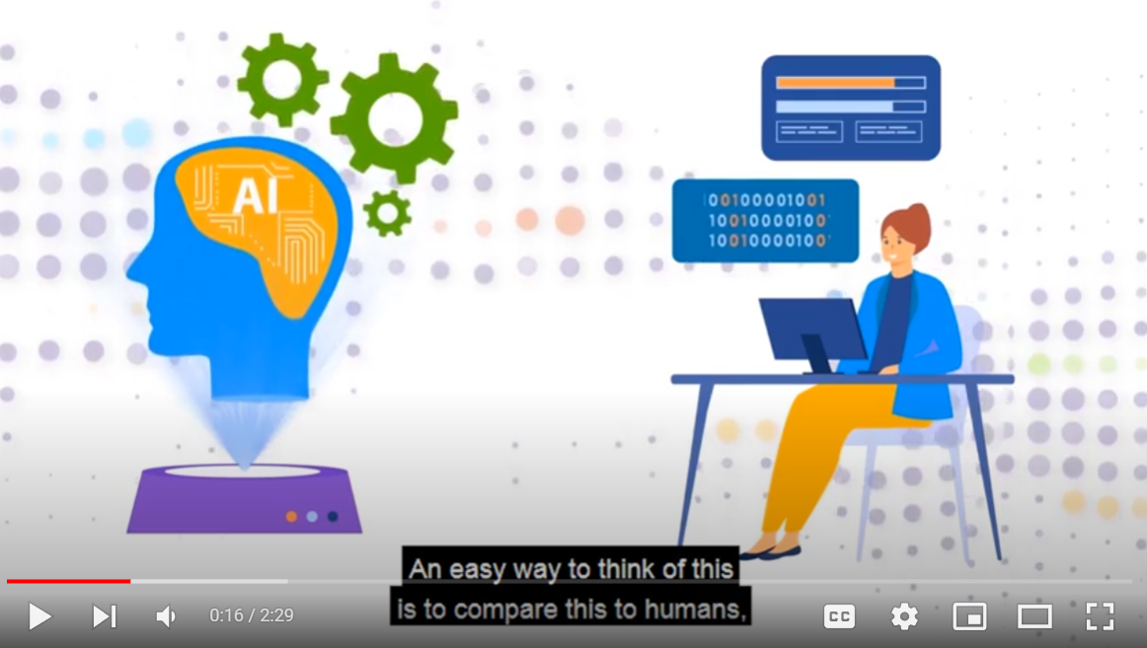
Decision Making and APIs
Decision Making and APIs | https://youtu.be/uAUP261Wwkw
Notes:
At Step 3 your students will decide what the decision or the outcome of the AI will be. The video on Slide 23 explains this final step, in preparation for your students trying out this three step process themselves.

Slide 24
Sprint 1
Investigating AI
Sprint 2
Building an AI concept
Sprint Two – Trying to build an AI concept
Goals:
As a team try to build an AI using the 123 Step Template to solve this challenge: ‘How can we use AI to reduce loneliness and depression amongst elderly people?’
Notes:
Sprint Two - Now it is time for your students to see if they can bring these three steps together to try to build an AI. For this sprint, have them put their own problem to the side for a moment, and instead try to solve the challenge ‘How can we use AI to improve the lives of elderly people?’. On Slide 25 there is plenty of information, but essentially what we have here to remind your students is the three step process, and a list of all of the APIs that they can draw upon.

Slide 25
Sprint 2 – Trying to build an AI concept
Goal: As a team try to build an AI using the 1,2,3 Step Template to solve this challenge: How can we use AI to reduce loneliness and depression amongst elderly people?’
Step 1
Data is collected.
(What APIs are being used?)
Step 2
This data goes into the AI.
(What is your container?)
Step 3
A decision or outcome is created by the AI.
(What APIs are being used?)
Vision Computer Vision
Analyze content in images and video.
Custom Vision
Customize image recognition to fit your business needs.
Face
Detect and identify people and emotions in images.
Form Recognizer
Extract text, key-value pairs, and tables from documents.
Ink Recognizer Recognize digital ink and handwriting, and pinpoint common shapes.
Video Indexer
Analyze the visual and audio channels of a video, and index its content.
Speech
Speech to Text
Transcribe audible speech into readable, searchable text.
Text to Speech
Convert text to lifelike speech for more natural interfaces.
Speech Translation
Integrate real-time speech translation into your apps.
Speaker Recognition
Identify and verify the people speaking based on audio.
Language
Immersive Reader
Help readers of all abilities comprehend text using audio and visual cues.
Language Understanding
Build natural language understanding into apps, bots, and IoT devices.
QnA Maker
Create a conversational question and answer layer over your data.
Text Analytics
Detect sentiment, key phrases, and named entities.
Translator
Detect and translate more than 60 supported languages.
Search
Bing Image, News, Video & Web Search
Search across a wide range of terms.
Bing Custom Search
Create a custom search engine with ad-free results.
Bing Entity Search
Recognize and classify named entities, and find search results based on them.
and objects.
Bing Spell Check
Help users identify and fix word breaks, slang, names, homonyms, and brands.
Decision
Anomaly Detector
Identify potential problems early on.
Content Moderator
Detect potentially offensive or unwanted content.
Metrics Advisor
Monitor metrics and diagnose issues.
Personalizer
Create rich, personalized experiences for every user.
Notes:
Sprint #2 - Now it is time for your students to see if they can bring these three steps together to try to build an AI. For this sprint, have them put their own problem to the side for a moment, and instead try to solve the challenge ‘How can we use AI to improve the lives of elderly people?’. On Slide 25 there is plenty of information, but essentially what we have here to remind your students is the three step process, and a list of all of the APIs that they can draw upon.

Slide 26
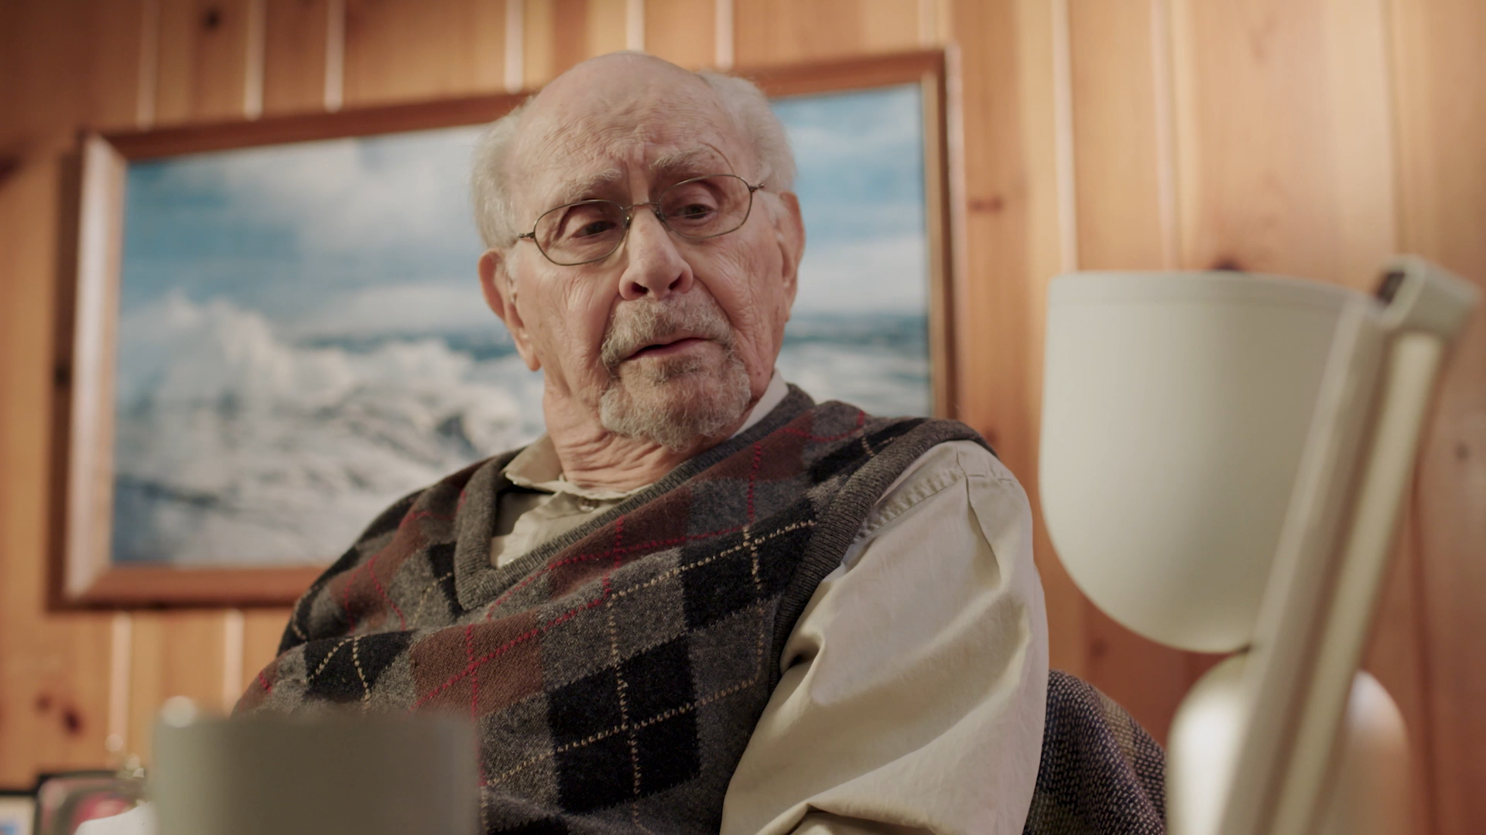
Rapid
Reflection
This video is a real-world solution to the challenge you just worked on.
What APIs may this AI be using?
What do you think of the ‘container’ (the little robot)?
Notes:
For some fun, we then have a video of an AI company that has created a unique solution to this problem of ‘How can we use AI to improve the lives of elderly people?’. As your students watch the short video of the Elli-Q AI, have them reflect on which APIs this could use, and what they think of the ‘container’ (in this sense a rather cute little robot).

Slide 27
Submission Tips
In the next lesson you will begin inventing your AI concept. The more you can include APIs in your submission, the more points you will get in Imagine Cup Junior!
Notes:
For the second last slide of this lesson, this is just a quick reminder that your students should ensure that they are including APIs as they think about the AI that they want to dream up, which is exactly what they will be doing in the next Lesson!

Slide 28
Challenge Check-in
What have you done so far?
In Lesson One you have learned about Imagine Cup Junior, the AI for Good categories, selected a problem and formed your team.
In this lesson you have learned about how AI works and begun building AI concepts with APIs.
What is next?
In the next lesson you are going to invent your AI concepts!
Notes:
Challenge check-in. This is a quick moment to recap what your students achieved in Lesson 2. Specifically:
Learn about the basics of Artificial Intelligence (AI).
Learn how to use API tools like APIs to build an AI.

Slide 29
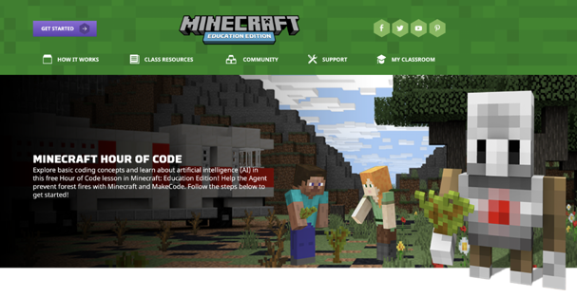
Bonus Activity!
If you want to learn more about basic coding concepts and go deeper in your learning about artificial intelligence why not try this free Hour of Code lesson in Minecraft: Education Edition!
https://education.minecraft.net/hour-of-code ​
Notes:
Bonus Activity - If your students have enjoyed the computer science elements of this lesson they may want to continue to explore AI and coding in this free Hour of Code lesson in Minecraft Education Edition. Hour Of Code 2020 | Minecraft: Education Edition as well as the AI activities on the next slide

Slide 30
More Bonus Activities!
Additional AI lessons are available in Minecraft: Education Edition! Check out these sustainability lessons using AI:
BUILD A POWER SOURCE
If we hope to achieve the UN's Sustainable Development Goals by 2030 the world will need all the creativity it can muster. Let's start planning today!
Build a Power Source | Minecraft Education
ALTERNATIVE ENERGY
Students explore sustainable energy systems.
Alternative Energy | Minecraft Education
CITY OF THE FUTURE
This lesson designed by Daniel Summerell, Hazel Glen College. Students design a future city addressing selected Sustainable Development Goals.
City of the Future | Minecraft Education
LIVING SUSTAINABLY
The world’s resources are running low. How can we use them to ensure sustainability for future generations?
Living Sustainably | Minecraft Education

Slide 31
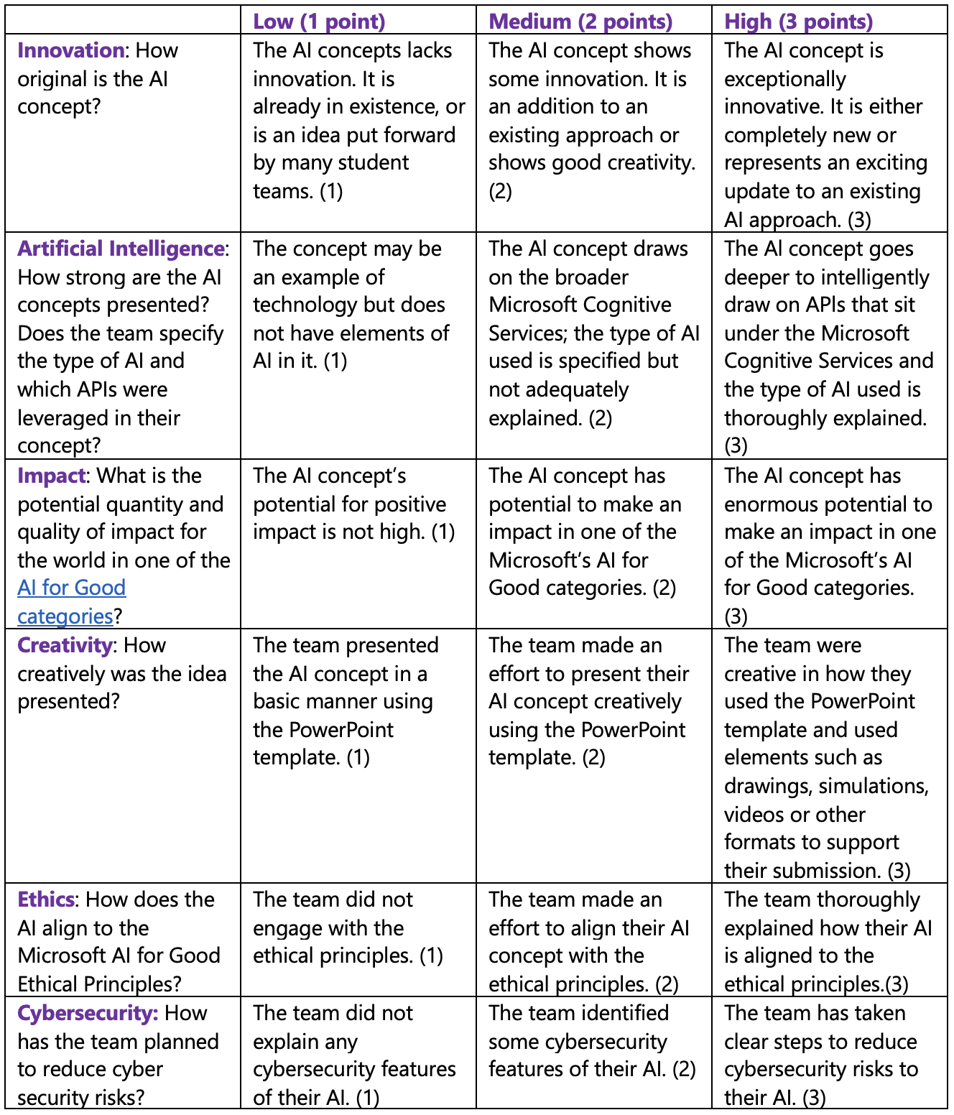
Judging Rubric
This is the rubric used by the judges to assess your student’s submissions. You can share this with your class and use it to guide their AI concepts as they fill out their PowerPoint Submission Template.
Notes:
Judging Rubric - This is the rubric used by the judges to assess your student’s submissions. You can share this with your class and use it to guide their AI concepts as they fill out their PowerPoint Submission Template.

